Slide 1

Zomato Data Analysis Project Report
Data Analyst Project
Rohit Rai

Slide 2
Contents
1. Introduction
2. Data Collection
(i) Importing Libraries
(ii) Gathering Data Files
(iii) Consolidating Data
3. Relation between Online Order Option and Restaurant Rating
4. Data Cleaning and Text Analysis
5. Performing Unigram Analysis and Stopwords Removal
6. Performing Bi-gram and Trigram Analysis
7. Extracting Geographical Coordinates from Data
8. Building Geographical Heat-Maps
9. Task Automation
10. Conclusion

Slide 3

Introduction
The Zomato Data Analysis project entails a detailed examination of restaurant data to uncover insights into user behavior and restaurant ratings. Utilizing Python libraries such as pandas, numpy, matplotlib, and seaborn, the data is processed, analyzed, and visualized to provide a comprehensive understanding of dining trends and preferences.

Slide 4
Data Collection
Data collection involves gathering and recording information for analysis or research purposes. Methods include surveys, interviews, observations, and data mining. It ensures relevant and accurate data is obtained to support decision-making, research objectives, or understanding phenomena in various fields such as science, business, and social sciences.
2.1 Importing Libraries
Importing essential libraries like pandas for data manipulation, numpy for numerical operations, matplotlib and seaborn for data visualization, and others is crucial in data analysis. These libraries collectively enable tasks such as data cleaning, transformation, statistical analysis, and creating insightful visualizations, essential for extracting meaningful insights from data.

Slide 5
Cont...
2.2 Gathering Data Files
The data for this project was gathered from various sources, including Zomato’s API and other public datasets. The glob module is commonly employed to dynamically gather file paths based on specified patterns, ensuring precise file access and streamlined processing.
2.3 Consolidating Data
In this project, each data file is individually read into a pandas DataFrame and then merged into a unified DataFrame using the pd.concat() function. This method consolidates disparate datasets into a cohesive format for seamless data exploration and insights generation.

Slide 6

Relation between Online Order Option and Restaurant Rating
This section focuses on analyzing whether there is a relation between the online order option and the rating of the restaurant. By visualizing and statistically analyzing the data, we aim to uncover patterns and insights that could inform business decisions.

Slide 7
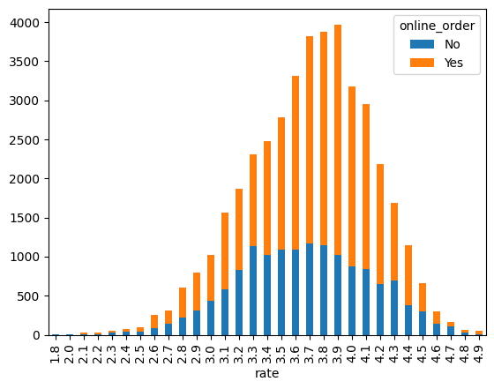
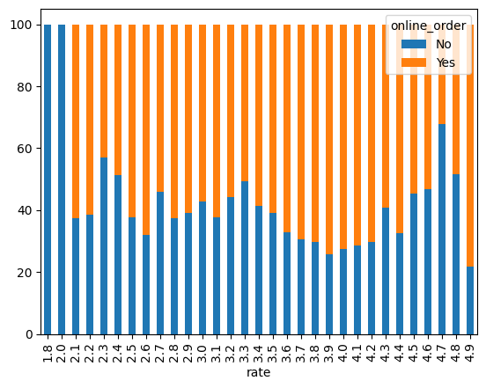
Relation...

Slide 8
Data Cleaning and Text Analysis
Data cleaning is performed to handle missing values and ensure proper data types. This step is crucial for preparing the data for subsequent text analysis, where unigram, bigram, and trigram analyses are conducted to understand customer sentiments and preferences better.

Slide 9
Performing Unigram Analysis and Stopwords Removal
Unigram analysis involves examining the frequency of single words in the dataset. Stopwords removal is performed to filter out common words that do not add significant meaning to the analysis.

Slide 10
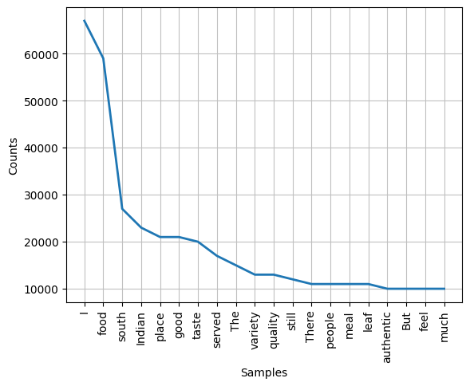
Performing...

Slide 11
Performing Bi-gram and Trigram Analysis
Bi-gram and trigram analyses involve examining the frequency of two-word and three-word combinations in the dataset, providing deeper insights into customer sentiments and preferences.

Slide 12
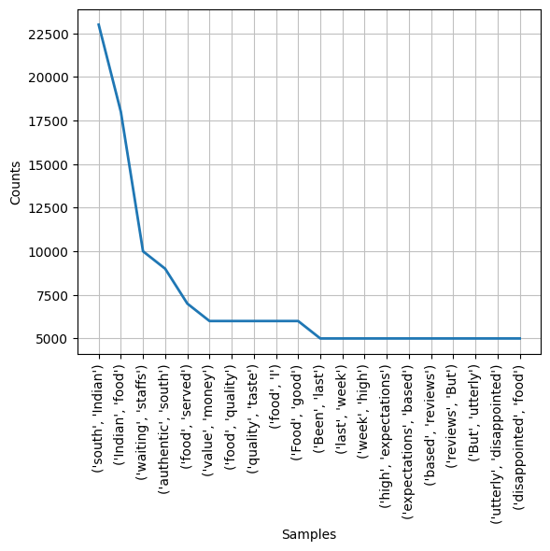
Performing...

Slide 13
Extracting Geographical Coordinates from Data
Geographical coordinates are extracted from the dataset to analyze the geographical distribution of restaurants and their ratings.

Slide 14
Building Geographical Heat-Maps
Geographical heat-maps are built to visualize the concentration of restaurants and their ratings across different regions, providing a clear picture of dining trends and preferences geographically.

Slide 15
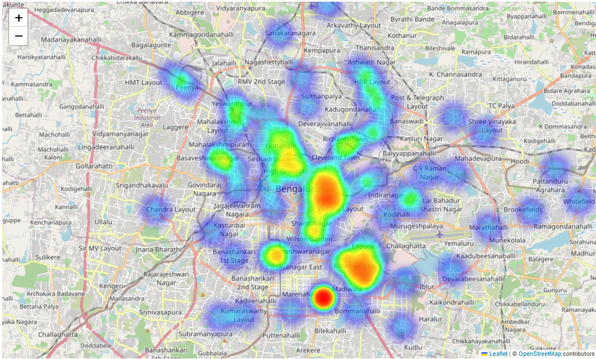
Building...

Slide 16
Task Automation
Automation scripts are developed to streamline repetitive tasks in the data analysis process, enhancing efficiency and accuracy.

Slide 17
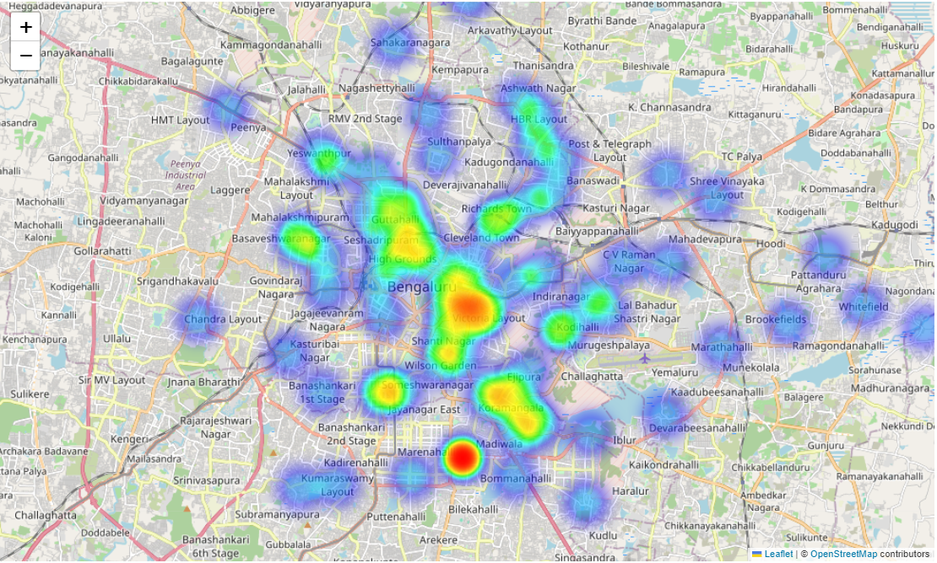
Task...

Slide 18
Conclusion
The Zomato Data Analysis project effectively leverages data science techniques to provide valuable insights into the restaurant industry. By analyzing trends in user ratings, geographical distribution, and customer sentiment, the project offers practical recommendations for restaurant owners and marketers to enhance their services and target their audience more effectively.

Slide 19
Thank You

